Slide 1
Public Employees Insurance Program
2026 Medicare Plan Options
Plans administered by:
Innovo Benefits Administration
952-746-3101
dan@innovomn.com

Slide 2
Medicare Basics
Original Medicare is comprised of two parts (Part A and Part B)
  Medicare Part A
    Automatically get when you turn 65 or have met the time worked requirement
    Offers very basic coverage for inpatient Hospitalizations/Skilled nursing/Hospice care
  Medicare Part B
    Must apply for, can be done through Social Security
    Don’t need to sign up for right away if you have creditable coverage
    Offers basic coverage for Doctors’ services/Outpatient care/Home health services/ Durable medical equipment
Part C
  Medicare Advantage Plans
    Offers additional medical coverage beyond Original Medicare
    Includes prescription drug coverage
Part D
  Stand alone prescription drug coverage

Slide 3
Changes for 2026
Effective 1/1/2026 UCare will no longer be offering Medicare Advantage Plans (Group or individual)
  Anyone enrolled in a UCare plan will need to enroll in a new plan during open enrollment for 1/1/2026
Prescription Drug Out of Pocket Maximum increasing $100
  New maximum will be $2,100

Slide 4
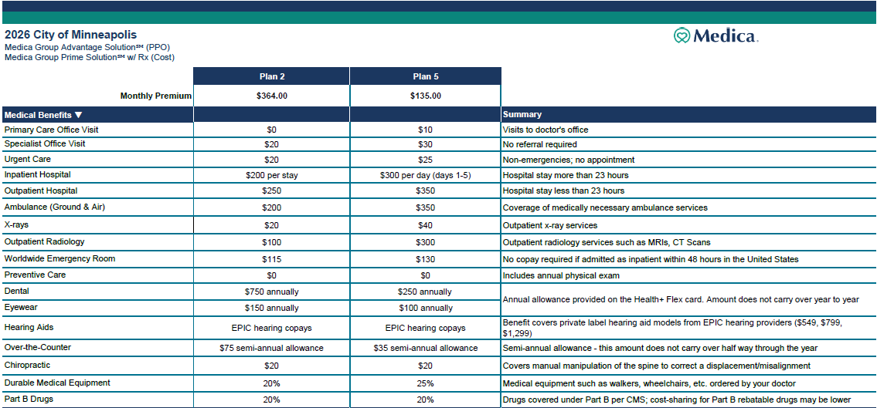
2026 Medica Plan Options

Slide 5
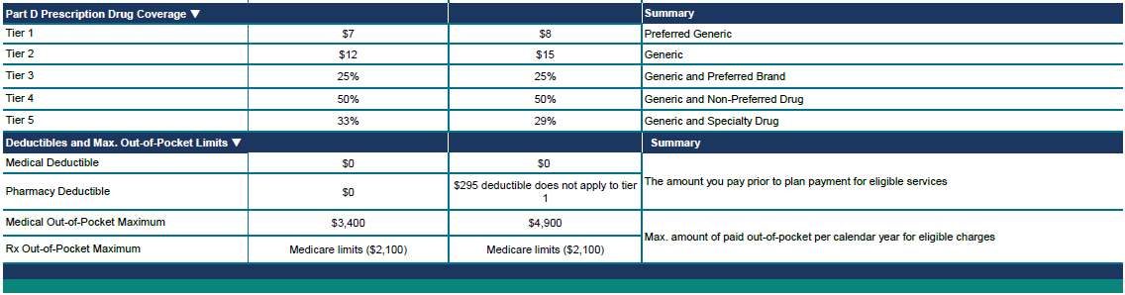
2026 Medicare Plan Options Cont.
Additional Plan Features:
Large Provider Network Open access to all providers who accept Medicare and are in the Medica network. No referrals are required. Visit medica.com/Medicare for a list of network providers.
OnePass™ Free fitness program gives you access to over 25,000+ locations nationwide − you can even enroll at multiple locations at the same time. Enjoy classes live or on-demand, exercise equipment and other amenities. Plus unlimited access to CogniFit online activities that support brain speed and memory.
Health Advocate™ 24-Hour NurseLine and Personal Health Advocate A 24/7 NurseLine and access to a Personal Health Advocate who can help you navigate the often complex healthcare system in unique ways such as arranging appointments with hard-to-reach specialists, finding doctors taking new patients, explaining your doctor’s instructions and much more.

Slide 6
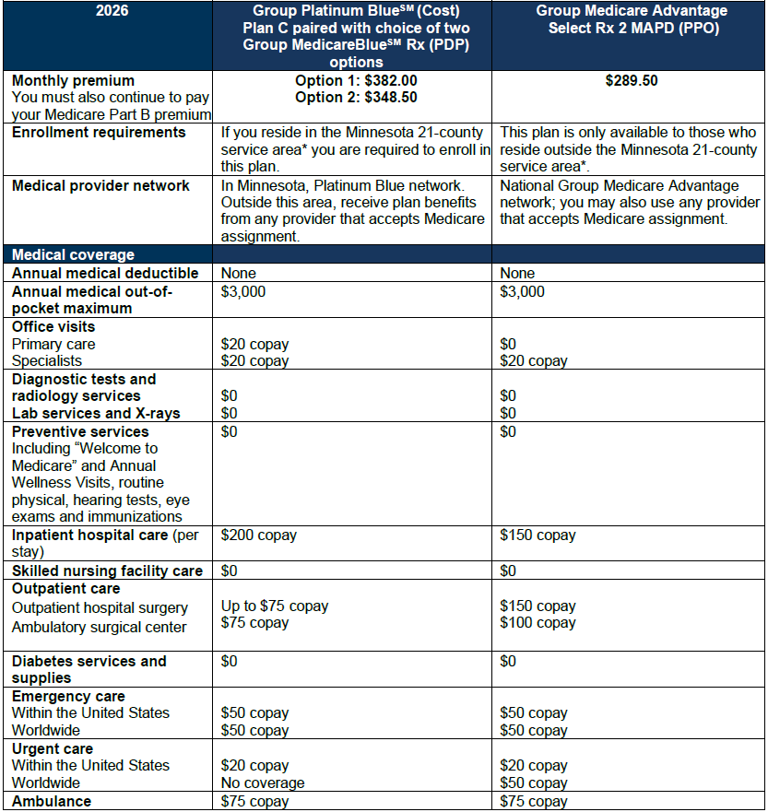
2023 GROUP MEDICARE PLAN COMPARISON
Public Employees Insurance Program
Blue Cross Blue Shield Plan Options
*Group Platinum Blue (Cost) service area (21 counties): Aitkin, Carlton, Cook, Goodhue, Itasca, Kanabec, Koochiching, Lake, Le Sueur, McLeod, Meeker, Mille Lacs, Pine, Pipestone, Rice, Rock, Sibley, St. Louis, Stevens, Traverse, and Yellow Medicine.

Slide 7
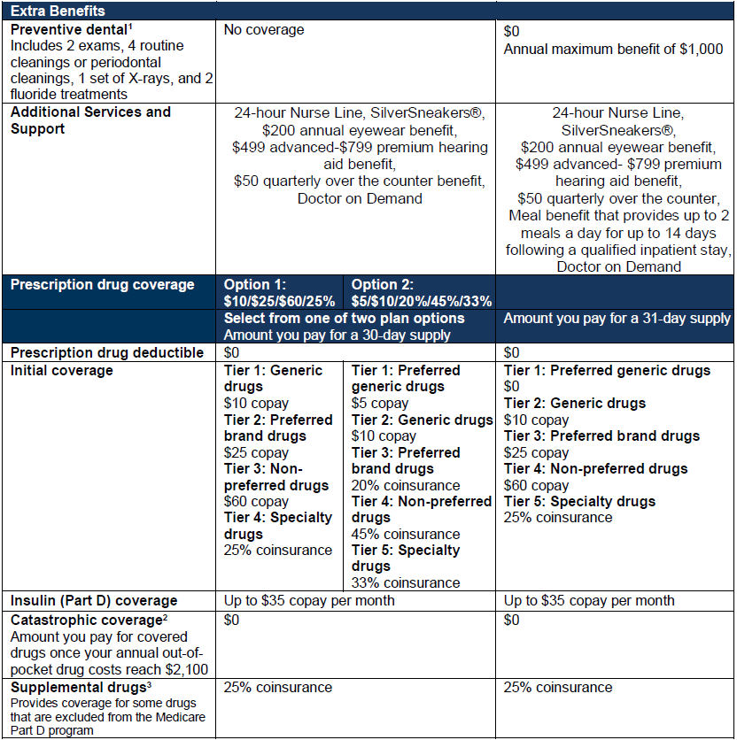
Blue Cross Blue Shield
Cont.

Slide 8
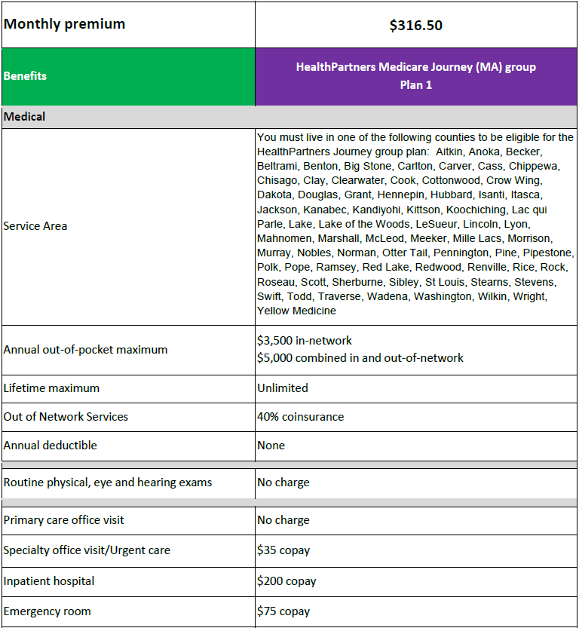
HealthPartners Plan 1

Slide 9
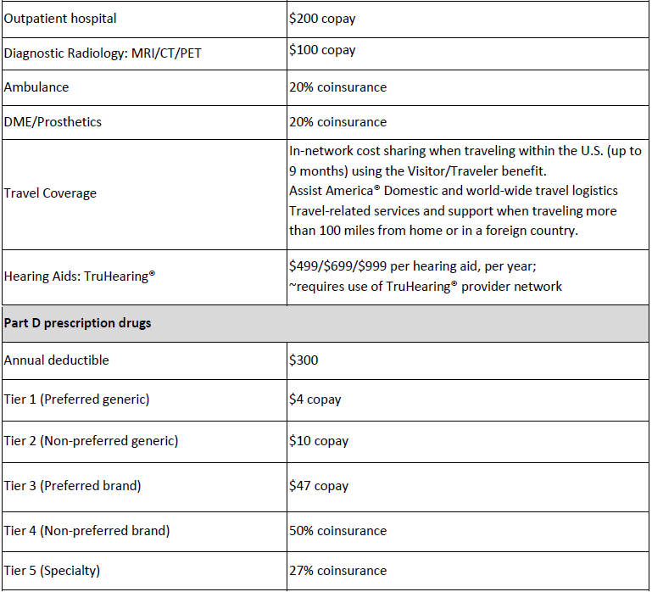
HealthPartners Cont.
Included Benefits and Discounts
• SilverSneakers® program: Free basic membership at participating fitness facilities in the national network, at-home workout kit, unlimited online classes
• Assist America®: Domestic and world-wide travel logistics. Experienced clinicians available by phone 24/7 to assist members in assessing their need for medical care and to coordinate post stabilization transport to the nearest medical facility or home. Member must be at least 100 miles from permanent residence for no longer than 90 consecutive days
• Telehealth services: E-visits, phone visits, online clinic visits (including unlimited Virtuwell® at no charge)
• Healthy Discounts: Discounts at participating retailers including eyewear, healthy eating programs, meal delivery, pet insurance, skin care services, wellness programs and many more

